Slide 1
Semi-Supervised Generative Adversarial Network (SGAN) for Nuclei Detection on Breast Cancer Histopathology Images
Victor M. Vargas
Seidenberg School of CSIS, Pace University.
New York City, NY.
victor@vmvargas.com

Slide 2
Agenda
Introduction
Previous Related Work
SGAN
Experimental Setup
Experimental Results
Conclusion and Future Work

Slide 3
Introduction
By measuring how cells react to various treatments, the researcher can understand the underlying biological processes at work.
We extended the work of an SGAN, combined it with the implementation of a DCGAN
Our goal was to evaluate if our model could find the probability of a given input image patch corresponding to a nucleus or not.
Our model was able to learn useful high-level features of nuclear structures as well as to generate visually appealing samples.

Slide 4
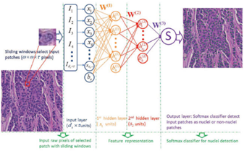
Previous Related Work
Stacked Sparse Autoencoder (SSAE) for Nuclei Detection on Breast Cancer Histopathology Images.

Slide 5
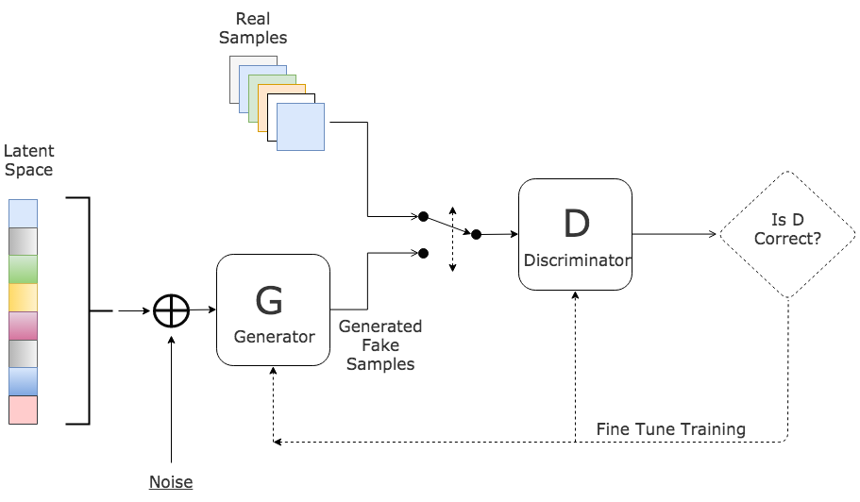
Previous Related Work
Generative Adversarial Networks (GAN)
Notes:
Non-Saturating Game
When the D becomes too smart the gradient for G saturates.
Each player has its own independent cost.
D remains the same.
G try to maximize the log probability of the D making a mistake.

Slide 6
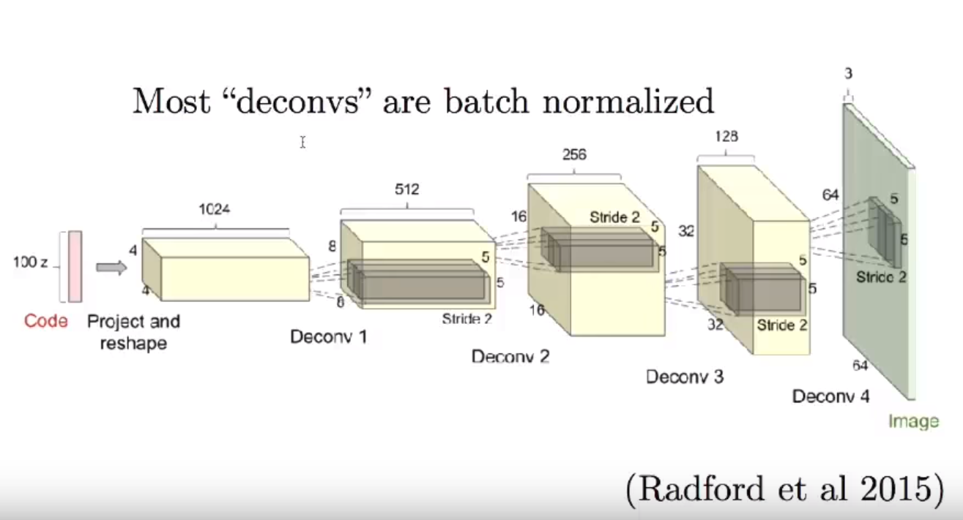
Previous Related Work
Deep Convolutional Generative Adversarial Networks (DCGAN)
GAN did not scale very large inputs at the beginning.
DCGAN provides richer techniques to scale to large inputs
Notes:
We use some of these architectural innovations
Stride > 1 when using deconv.
Use batch normalization in both (G and D) and at every layer except for the last.
Use ReLU activation in generator for all layers except for the output, which uses Tanh.
Use LeakyReLU activation in the discriminator for all layers

Slide 7
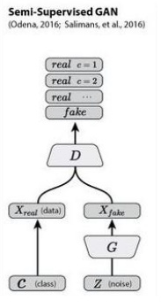
SGAN
Odena forced D to output N+1 different output classes, N different “real” classes, and an additional fake class (anything that comes from G). In our case, N=2 (real nuclei, and real non-nuclei).
Notes:
Odena [12] proposed an extension of the DCGAN architecture to the semi-supervised context by forcing D to output N+1 different output classes, N different “real” classes, and an additional fake class (anything that came from G). In our case, N=2 (real nuclei, and real non-nuclei).

Slide 8
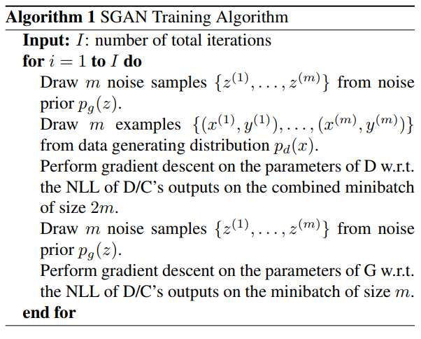
SGAN
D is trained to minimize the negative log likelihood with respect to the given labels and G is trained to maximize it.
Notes:
Our work can be seen as a refinement of this method adapted to perform nuclei detection.

Slide 9
Experimental Setup
TMI Dataset
We did not use the testing dataset. Instead we used the validation as the testing dataset.
The training data includes 2,000 nuclear and 6,000 non-nuclear patches. There are 1,000 patches for validation, 500 nuclear patches and 500 non-nuclear.
The value range of each image was originally [0…1] but we normalize it to be [-1…1].
We modify training and testing labels. 0 represents non-nucleus, 1 represents nucleus.
Notes:
Initially, we conducted experiments on MNIST to see whether the classifier component (D) of our model could perform as intended and similar to the original implementation.

Slide 10
Experimental Setup
Parameter setting
Every image from the training dataset was downscaled to 32×32 = 1024 pixels
We used Adam optimizer with tuned hyper-parameters. 0.0002 as the learning rate, and 0.5 as momentum term β1.

Slide 11
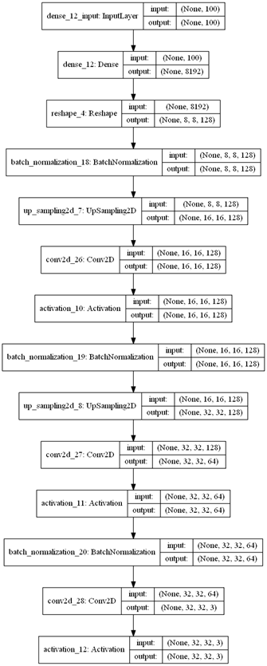
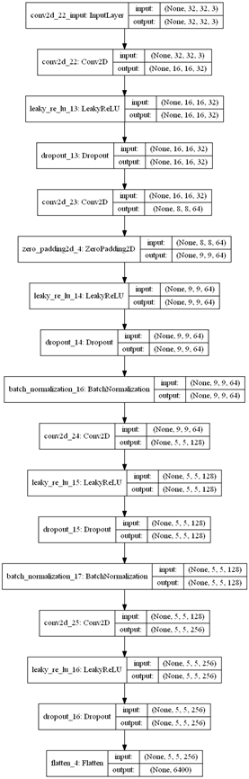
Experimental Setup
G model’s Graph Discriminator
model’s graph
Notes:
We used almost all architecture guidelines suggested by Radford [5] for a stable Deep Convolutional network:
• Replace any pooling layers with strided convolutions (discriminator) and fractional-strided convolutions (generator).
• Use batchnorm in both the generator and the discriminator.
• Remove fully connected hidden layers for deeper architectures.
• Use ReLU activation in generator for all layers except for the output, which uses Tanh.
• Use LeakyReLU activation in the discriminator for all layers.

Slide 12
Experimental Setup
Training the SGAN for Nuclei Detection
For each epoch, we Mini-batch discrimination.
Training the Discriminator (D)
D’s is trained by minimizing the cross-entropy between the observed labels and the model predictive distribution Pmodel (y|x).
D have N+1 output units corresponding to [CLASS-1, CLASS-2, ... CLASS-N, FAKE].
Notes:
200 epochs, batch size 32
For each epoch, we selected a random half batch of images from the TMI training set (16 images) and another random half samples from a Gaussian distribution. To balance the difference in occurrences of class labels, 50% of labels that the D trains on are “fake”.
Refer to paper
Semi-supervised learning for Nuclei Detection

Slide 13
Experimental Setup
Training the Generator (G)
The Generator follows a very standard implementation described in the DCGAN paper.
G is trained 10 times per epoch to overcome a failure mode in where D overpowered G.
Notes:
200 epochs, batch size 32
For each epoch, we selected a random half batch of images from the TMI training set (16 images) and another random half samples from a Gaussian distribution. To balance the difference in occurrences of class labels, 50% of labels that the D trains on are “fake”.
Refer to paper
Semi-supervised learning for Nuclei Detection

Slide 14
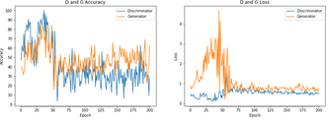
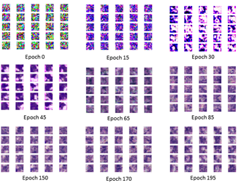
Experimental Setup
Training the Generator (G)

Slide 15
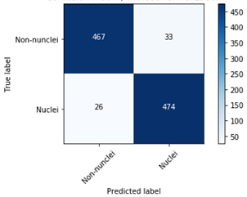
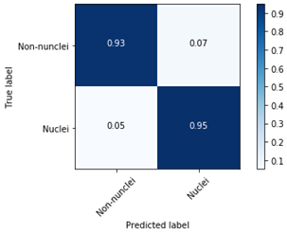
Experimental Results
SGAN Confusion Matrix with and without normalization
Notes:
D’s overall classification accuracy across the 1,000 testing was 94.100%. Thus, D’s error rate is 0.59.

Slide 16
Experimental Results
 | Precision (%) | Recall (%) | F-measure (%) | Support (%)
Non-Nucleus | 95 | 93 | 94 | 500
Nucleus | 93 | 95 | 94 | 500
Avg / Total | 94 | 94 | 94 | 1000
Model | Precision (%) | Recall (%) | F-measure (%) | AveP (%)
SSAE-SMC | 88.84 | 82.85 | 84.49 | 78.83
SGAN | 94 | 94 | 94 | 93.2
The mean associated with Precision, Recall, F-measure and Average Precision (AveP) for SSAE+SMC, and SGAN’s D
SGAN’s D Classification Report

Slide 17
Conclusion and Future Work
The model can capture high-level feature representations of pixel intensity in a semi-supervised manner.
These high-level features enable the classifier to work very efficiently for detecting multiple nuclei from a large cohort of histopathological images as well as to generate realistic synthesized representations of nuclei and non-nuclei images.
Notes:
Regardless of the difference in the testing approach and dataset that both models used, the SGAN model appear to suggest that it works well in learning useful high-level features for better representation of nuclear structures. However, these evaluation is not enough to conclude that it can outperform state-of-the-art methods on nuclei detection

Slide 18
Conclusion and Future Work
We are eager to explore the following related ideas to improve our results and arrive to a more certain conclusion:
Replicate the testing procedure from Xu et al. And implement the same qualitative, quantitative and sensitivity analysis to have a better intuition when comparing both models.
Improve SGAN model training by evaluating the impact of recently published techniques such as: One side label smoothing, Historical averaging, Virtual Batch Normalization (VBN), and Inception Scoring proposed by Salimans et al., Feature Matching, Adding some artificial noise to inputs.
Notes:
Regardless of the difference in the testing approach and dataset that both models used, the SGAN model appear to suggest that it works well in learning useful high-level features for better representation of nuclear structures. However, these evaluation is not enough to conclude that it can outperform state-of-the-art methods on nuclei detection

